Slide 1

Comprehensive SEO Audi & Optimization for organic traffic growth
Presented by : Sathish Kumar.R
Batch Code : MBT11

Slide 2

01.
Initial Audit
02.
Keyword Research
03.
On-Page SEO Optimization Audit
04.
Technical Support
05.
Content Strategy
PROJECT
TASK
06.
Off-Page SEO

Slide 3

Company selection
I selected the company “EffiaSoft (https://effiasoft.Com/) for this project
About EffiaSoft :
EffiaSoft’ vision is to be omnichannel at every billing point with EFFicient,Intelligent and Affordable technology.
These values provide the foundation on which we make a difference for our customers and our people in their professional lives.

Slide 4
ABOUT COMPANY
Artifical
intelligence
Business
intelligence
Advanced
Integrity
Innovation
Service excellence
Accountability
Data science
Computer vision
Optimize inventory
Manage expenses
Reports & Growth
Manage Vendors

Slide 5
Task No: 01
Initial
Audit

Slide 6
Current performance :
Designed to grow your business , no matters how complex your opertions are!
EffiaSoft offers a suite of Point of Sale (POS) software solutions tailored for retail, restaurants, distribution, and inflight services.
Strengths :
Features for various industries.
Free versions available for small businesses.
Weaknesses :
The pages makes 123 requests. More than 20 requests can result in slow page loading
Dependency on the internet for cloud features might limit usage in areas with poor connectivity.
Ensure that all images on your website have an alt tag with descriptive, useful information. This improves accessibility and SEO by allowing search engines to understand the content of the images.

Slide 7
Task No : 02
Keyword
Research

Slide 8
Targeted Keywords :
Primary Keywords : POS Software, Billing Software .
Secondary Keywords : Retail POS , Restaurant POS, Distribution software , inflight POS
Long-Tail Keywords : Cloud-based POS software for retail , Restaurant billing and inventory management system , Affordable POS software for small businesses
Compectitive Analysis :
EffiaSoft faces a competitive landscape in the POS software market, with strong rivals
EffiaSoft's primary competitors are Nippon Data Systems, Techzone India, Vanuston Intelligence are three majar competitor in india

Slide 9
Task No : 03
On-Page SEO
Optimization Audit

Slide 10
Selected pages : https://effiasoft.com/business-apps/distribution-management-software/Best Distribution Management Software | Distributor Software (effiasoft.com)
Strengths :
Features for various industries.
Free versions available for small businesses.
Weaknesses :
Title tag : The title tag has 60 characters. Title tag should have 50-60 characters. EffiaSoft's distribution management software page could be more descriptive for SEO.
Meta description: The description might not clearly convey the unique value propositions or benefits of the software, making it less for potential users

Slide 11
Heading : 3 H1 tags were found. For the best SEO results there should be exactly one H1 tag on each page.
Content : Make sure every image has an alt tag, and add useful descriptions to each image. Add your keywords or synonyms - but do it in a natural way.
Actionable Items :
Optimize meta descriptions with target keywords and compelling calls to action.
Add links to external resources that are useful for your readers. Make sure you link to high-quality sites - Google penalizes pages that link to "spammy" sites
Try to replace embedded objects with HTML5 alternatives.
Caching plugins keep a cached version of each page on your site. Instead of building the page from scratch, the server will send the cached copy.

Slide 12
Task No : 04
Technical SEO

Slide 13
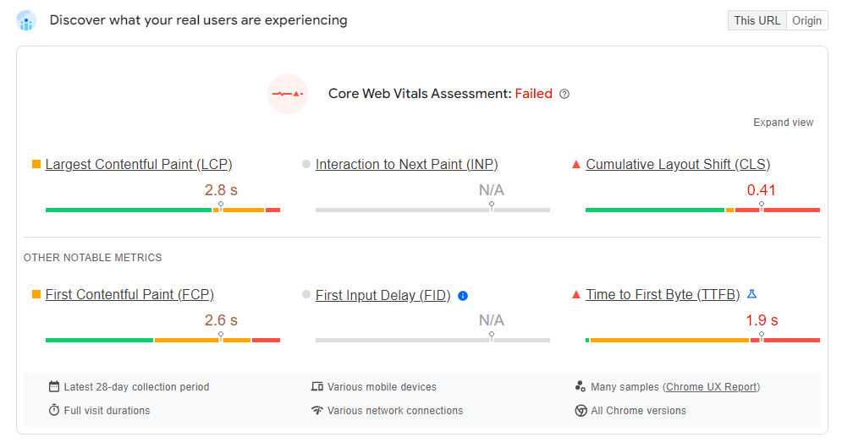
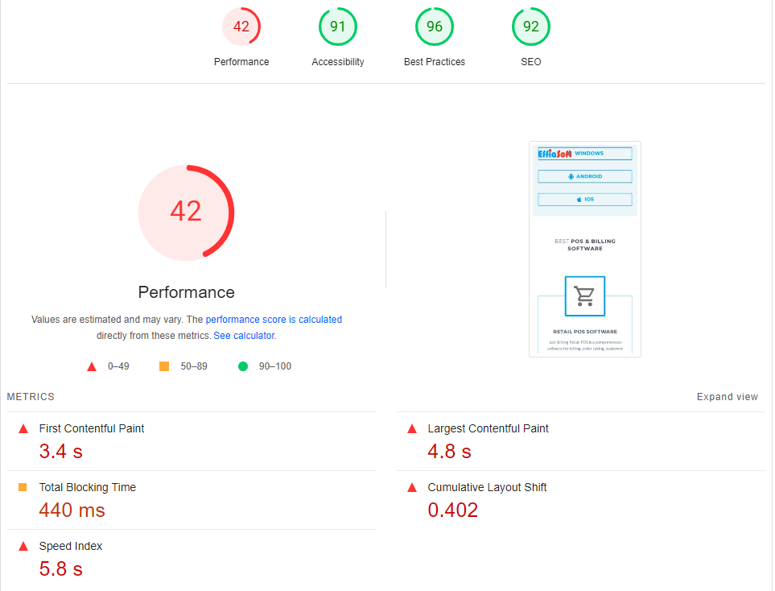
Technical SEO Issues ( Website Homepage).
Missing information :
The publisher name, keywords, Author are missing.
The ratio of internal links to external links is uneven.
Some Javascript files don't seem to be minified.
Potential issues :
Ensure full mobile responsiveness and fix any layout issues.

Slide 14
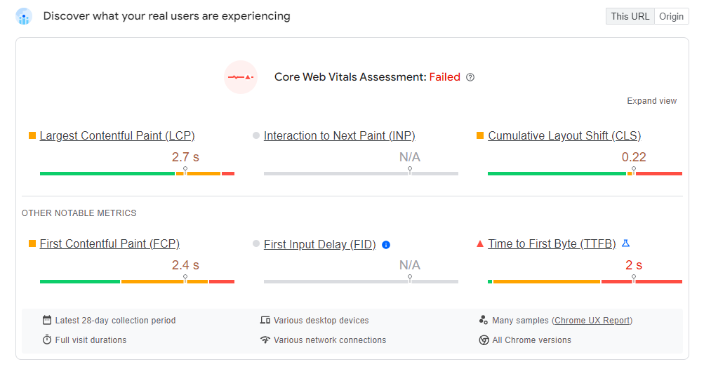
Potential issues :
Optimize for faster loading times by compressing images. Desktop speed should have been improved.

Slide 15
5 Best Practices to Improve Site and Web Page Speed :
Optimize Image : Compress and resize images to reduce load times without sacrificing quality.
Minify and compress code : Remove unnecessary code and whitespace to reduce file sizes.
Meta description: The description might not clearly convey the unique value propositions or benefits of the software, making it less for potential users
Utilize a Content Delivery Network (CDN) : Distribute content across multiple servers to decrease latency.xxx
Leverage Browser Caching : Enable caching to store static resources locally for faster loading.

Slide 16
Task No : 05
Content
Strategy

Slide 17
Develop content based on identified target audience and Keyword research
Blog No 1 : Retail Inventory management Software : Streamlining your Business for Sucess
In the ever-evolving world of retail, efficient inventory management is the key to success. Retail Inventory Management Software, often abbreviated as RIMS, has become an indispensable tool for retailers of all sizes. This software solution helps businesses track, manage, and optimize their inventory processes, ensuring that products are readily available, reducing costs, and enhancing overall operational efficiency. In this article, we will delve into what Retail Inventory Management Software is, explore its essential features, and outline the myriad benefits it brings to retailers.

Slide 18
Blog Topics No 2 : Retail POS Systems An Overview
When small business owners want to upgrade their POS system or invest in one for the first time, they don’t know where to start.
So, let’s start with the basics. There are two components of a modern POS system.
Hardware: POS hardware includes terminals, card readers, checkout scanners, mobile inventory scanners, and similar technology that processes payments and scans information into the system. Some POS systems also integrate with other software that allows you to use your smartphones and mobile devices to cut down on costs.
Software: POS software is where modern systems really shine for small businesses (and where the various systems differ the most). In addition to handling payments, your POS system can track inventory levels, streamline vendor management, set up customer loyalty and discounts, integrate with e-commerce, and more.
The best POS systems for retail provide small businesses with the tools they need to meet customer expectations, increase profit margins, and stand out against bigger competitors.

Slide 19
Task No : 06
Off-Page SEO

Slide 20
Off-Page SEO Plan and Strategy :
Link Building : Focus on acquiring high-quality backlinks from industry-related websites, blogs, and forums to enhance domain authority.
Guest Blogging : Contribute articles to reputable industry blogs to establish authority and gain backlinks.
Online Directories : Submit the website to relevant online business directories and ensure consistent information.
Social Media Marketing : Platforms like LinkedIn, Twitter, Facebook and Youtube to share content, engage with the audience, and drive traffic.
Online Reviews : Encourage satisfied customers to leave positive reviews on platforms like Google My Business. Respond to reviews to build trust and engagement.

Slide 21
Outcome of the project
The expected outcomes for EffiaSoft’s project would include enhanced online visibility, increased organic traffic, higher search engine rankings, improved user engagement, and greater brand authority.
Through the implementation of on-page and off-page SEO strategies, technical optimizations, and content plan, EffiaSoft can expect better lead generation, a stronger online presence, and ultimately, higher conversion rates on their website.

Slide 22
Conclusion
01.
EffiaSoft will drive more organic traffic, improve search engine rankings, and ultimately lead to better customer engagement and conversions. By focusing on continuous improvement and adapting to SEO best practices, EffiaSoft can establish a strong online presence and achieve sustained growth.
PROBLEM VS SOLUTION
Liceria & Co.

Slide 23
THANK YOU
Presented by : Sathish Kumar R
Batch Code : MBT11

